Slide 1
VIRTUALIZATION

Slide 2
Virtualization
Virtualization -- the abstraction of computer resources.
Virtualization hides the physical characteristics of computing resources from their users, be they applications, or end users.
This includes making a single physical resource (such as a server, an operating system, an application, or storage device) appear to function as multiple virtual resources; it can also include making multiple physical resources (such as storage devices or servers) appear as a single virtual resource.
Notes:
The process of converting a physical IT resource into virtual IT resource is called virtualization.

Slide 3
System Without Virtualization
Applications
Operating
System
Hardware

Slide 4
System With Virtualization
Applications
Operating
System
Hypervisor
Hardware
Notes:
Hypervisor is a software program that manages multiple operating systems (or multiple instances of the same operating system) on a single computer system.
The hypervisor manages the system's processor, memory, and other resources to allocate what each operating system requires.
Hypervisors are designed for a particular processor architecture and may also be called virtualization managers.

Slide 5
Application
Application
Application
Applications
Application
Applications
Operating
System
Operating
System
Operating
System
Operating
System
Operating
System
Operating
System
Hardware
Hypervisor
Hardware
Notes:
Both the guest operating system and the application software running on the virtual server are unaware of the virtualization process, meaning these virtualized IT resources are installed and executed as if they were running on a separate physical server.

Slide 6
Types of Virtualization:
Hardware Virtualization.
Operating system Virtualization.
Server Virtualization.
Storage Virtualization.

Slide 7
Hardware Virtualization:
When the virtual machine software or virtual machine manager (VMM) or hypervisor software is directly installed on the hardware system is known as hardware virtualization.
The main job of hypervisor is to control and monitoring the processor, memory and other hardware resources.
After virtualization of hardware system we can install different operating system on it and run different applications on those OS.
Notes:
Hardware virtualization is mainly done for the server platforms, because controlling virtual machines is much easier than controlling a physical server.

Slide 8
Advantages:
More Efficient Resource Utilization
Lower Overall Costs Because Of Server Consolidation
Increased Uptime Because Of Advanced Hardware Virtualization Features

Slide 9
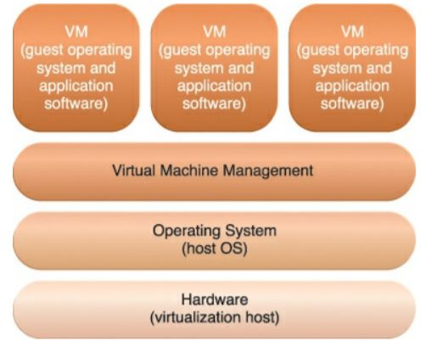
Operating System-Based Virtualization
Notes:
is the installation of virtualization software in a pre-existing operating system, which is called the host operating system

Slide 10
Server Virtualization
The coordination function that is provided by the virtualization software allows multiple virtual servers to be simultaneously created in the same virtualization host. Virtualization technology enables different virtual servers to share one physical server. This process is called server consolidation and is commonly used to increase hardware utilization, load balancing, and optimization of available IT resources.
Notes:
The resulting flexibility is such that different virtual servers can run different guest operating systems on the same host.

Slide 11
Storage Virtualization
Storage virtualization is the pooling of physical storage from multiple storage devices into what appears to be a single storage device -- or pool of available storage capacity -- that is managed from a central console. The technology relies on software to identify available storage capacity from physical devices and to then aggregate that capacity as a pool of storage that can be used in a virtual environment by virtual machines (VMs).

Slide 12
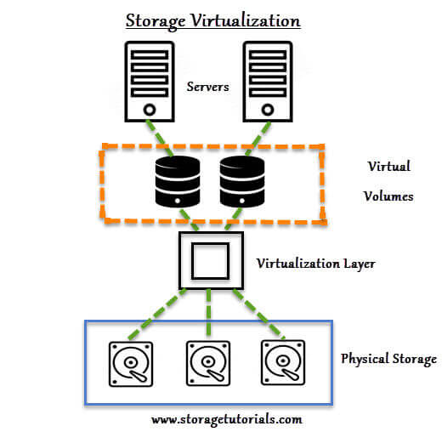
Notes:
Ex: Googe Drive, OneDrive(Microsoft)

